Slide 1
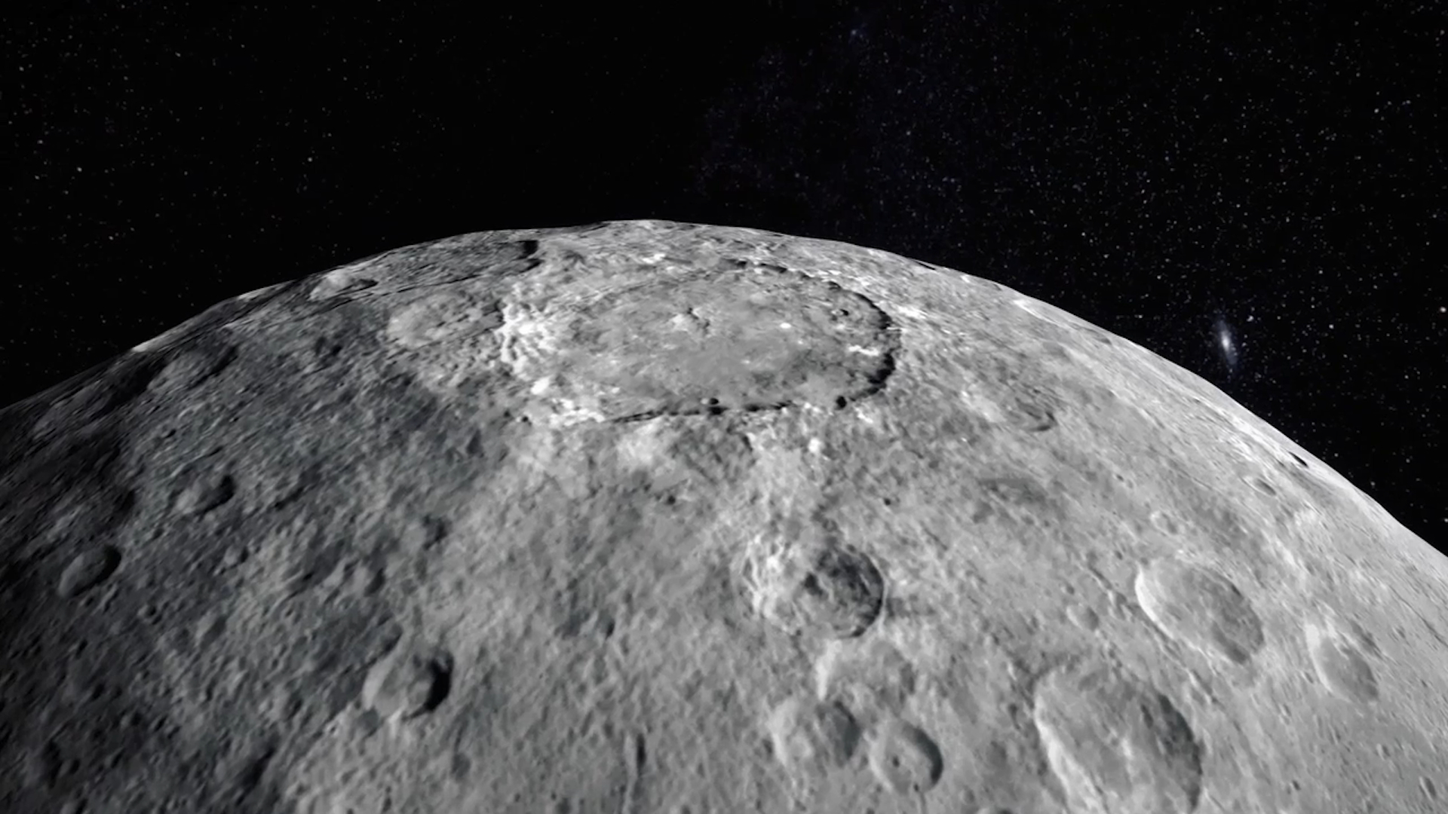
CERES
THE DWARF PLANET
Presented by: HARSHITA AGARWAL
BCA 1st year
Notes:
A template for students to design a field trip to a location for other students to view. Includes directions to the student of what to include on each slide and what content should be considered.

Slide 2
CONTENTS:
Introduction
Namesake
Potential for Life
Size and Distance
Orbit and Rotation
Formation and Structure
Surface and Atmosphere
Moons, Rings & Magnetosphere
Pop Culture
Conclusion

Slide 3
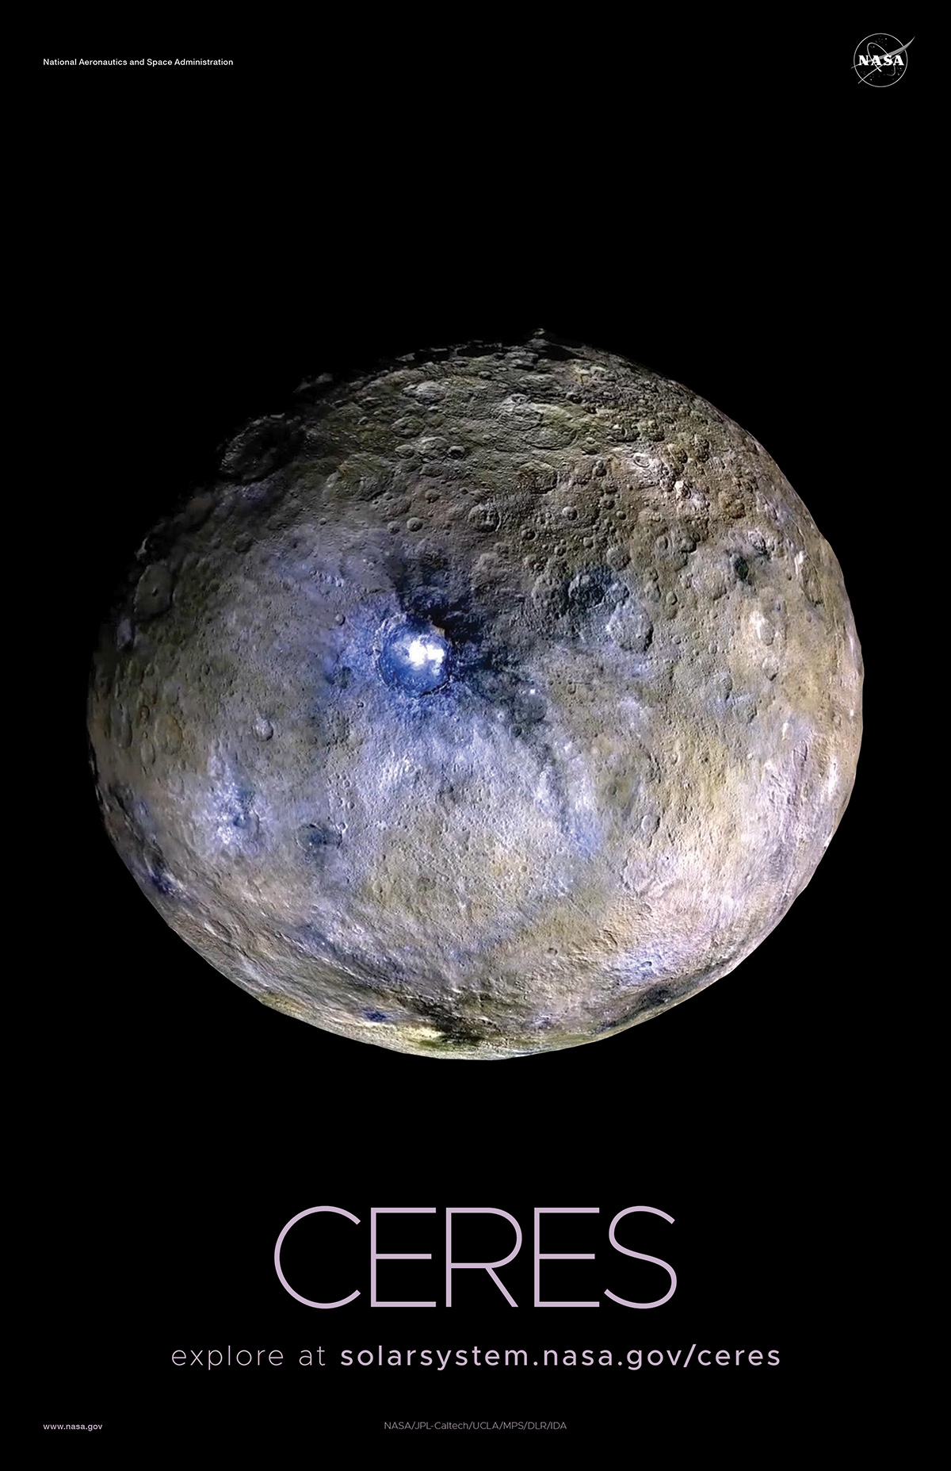
INTRODUCTION TO CERES
Ceres is the largest object in the asteroid belt between Mars and Jupiter.
First discovered in 1801 by Giuseppe Piazzi.
Visited by NASA’s Dawn spacecraft in 2015.
Reclassified as a dwarf planet in 2006 due to its size and unique features.
Comprises 25% of the asteroid belt’s total mass, though Pluto is 14 times more massive

Slide 4

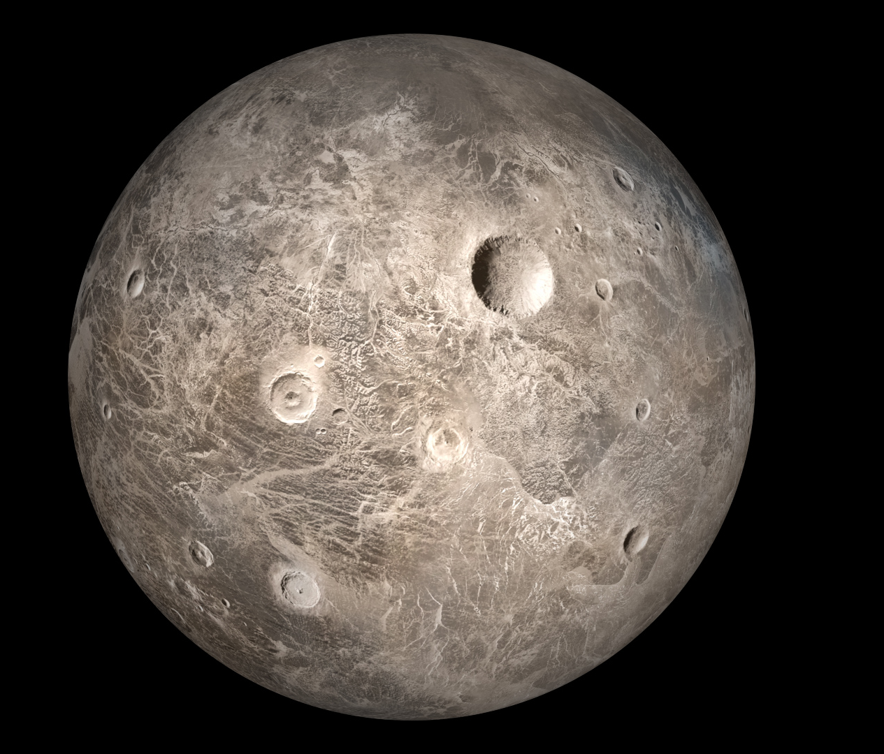

NAMESAKE
Named after CERES, Roman goddess of corn and harvests.
The word cereal is derived from her name

Slide 5
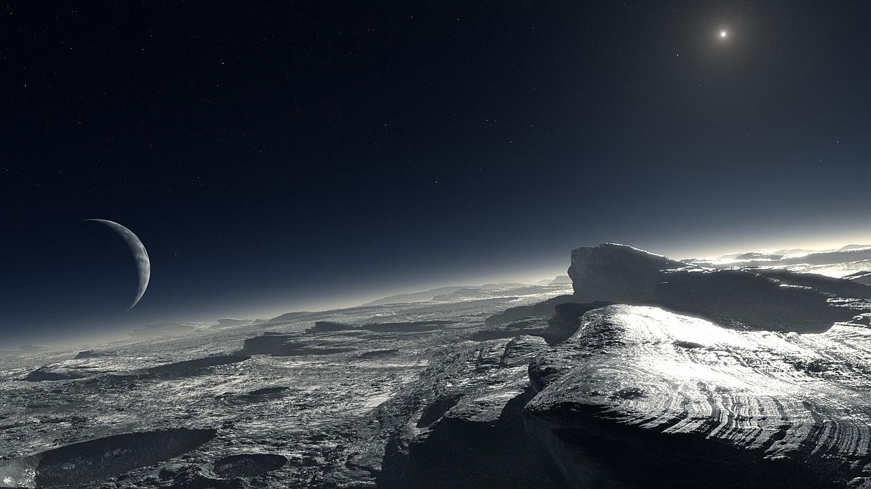
POTENTIAL FOR LIFE
Ceres contains water – an essential ingredient for life
Scientists speculate it could host microbial life or show signs of past life.
Water may exist as ice or vapor, possibly from ice volcanoes or sublimation.
Notes:
For example, Astoria Oregon is a town on the Oregon coast well know for its starring role in the movie “The Goonies”. Today, we will take a trip from our school to Astoria through miles and time…

Slide 6
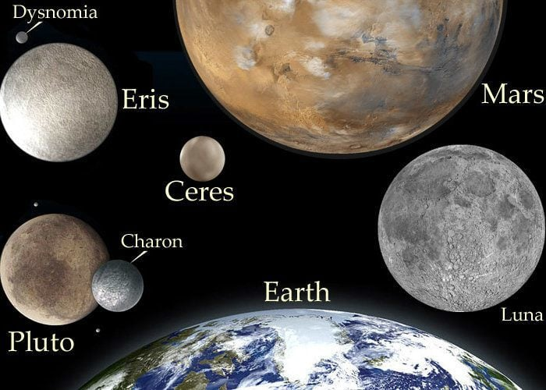
SIZE AND DISTANCE
Radius: 296 miles (476 km), about 1/13 of Earth’s radius.
If Earth was a nickel, Ceres would be a poppy seed.
Distance from Sun: 257 million miles (413 million km) or 2.8AU.
Sunlight takes ~22 minutes to reach Ceres.

Slide 7
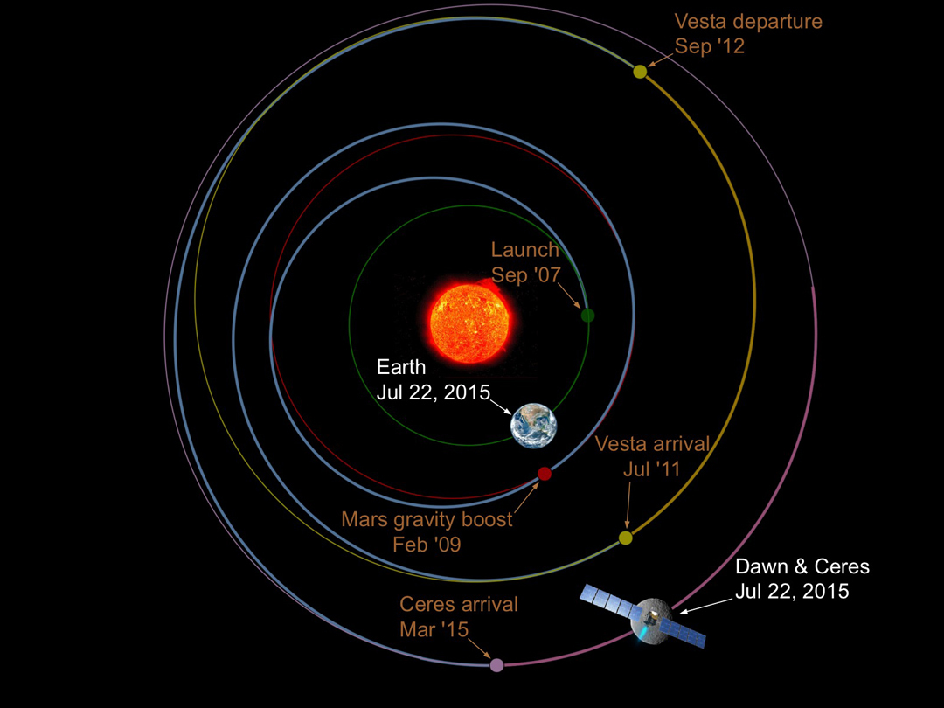
ORBIT & ROTATION
Orbital period: 4.6 Earth years (1,682 days)
Rotational period: 9 hours – one of the shortest in the solar system
Axis tilt: 4°, meaning no significant seasons

Slide 8
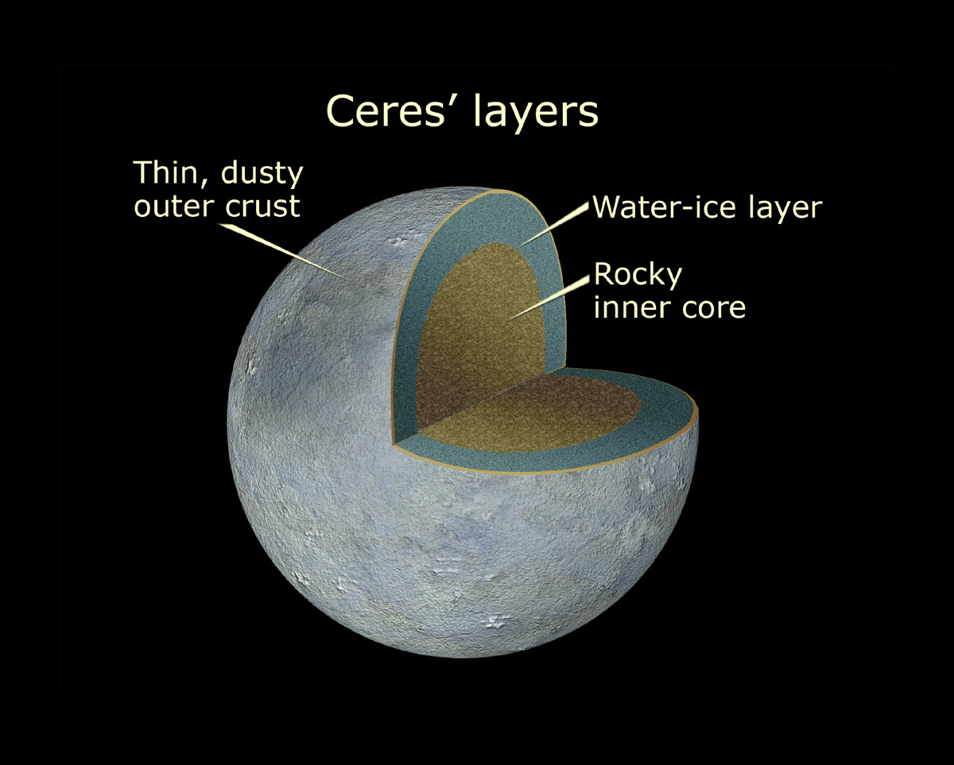
CERES’
FORMATION AND STRUCTURE
Formed ~4.5 billion years ago; considered an “embryonic planet”.
Jupiter’s gravity prevented full planetary development.
Likely has a solid core and icy mantle, may contain 25% water.
Crust is rocky and dusty with salt deposits (e.g., magnesium sulfate)
Notes:
You can use this type of slide for text, images, shapes and tables to help add information in a different way. Duplicate this slide to add additional images of important location in your visit.

Slide 9
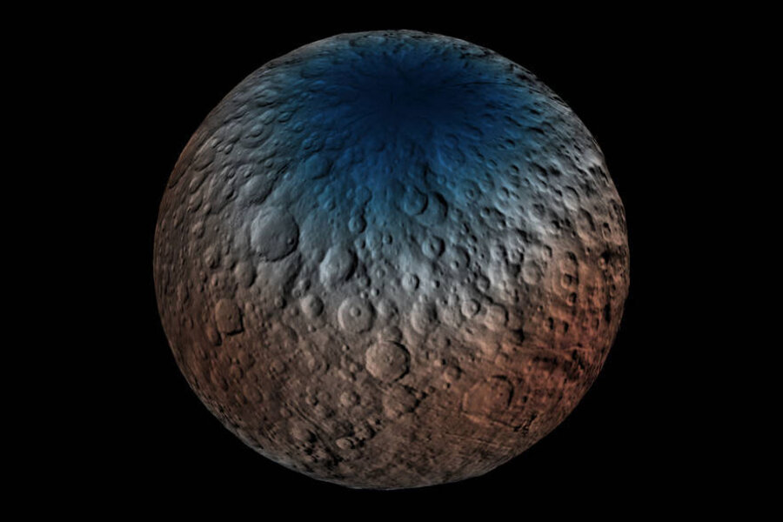
SURFACE, ATMOSPHERE & MORE
Surface: Young craters, none larger than 175 miles.
Possible ice volcanoes and cold traps with long-lasting ice.
Thin atmosphere with water vapor
No moons, no rings and no detectable magnetosphere
Notes:
You can use this type of slide for text, images, shapes and tables to help add information in a different way. Duplicate this slide to add additional images of important location in your visit.

Slide 10
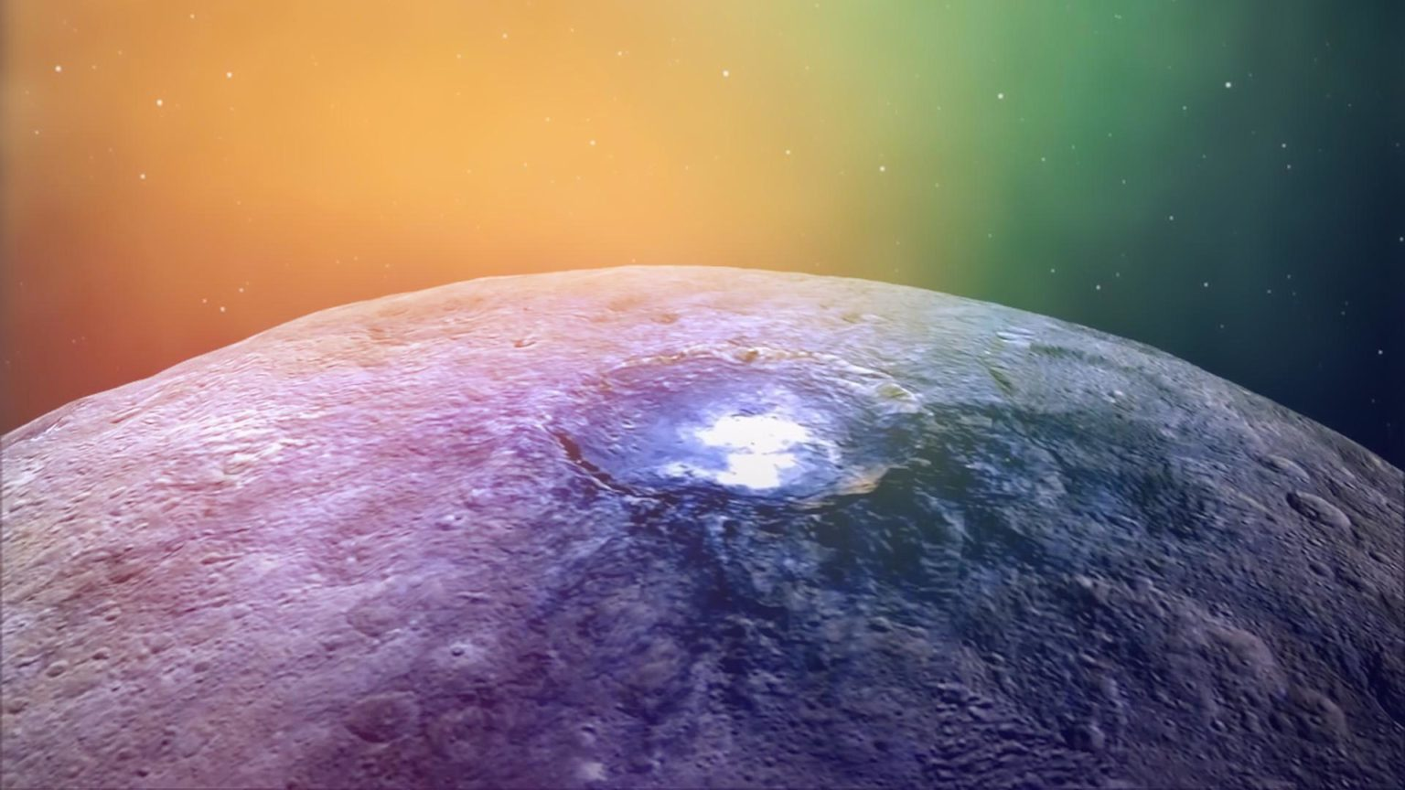
AMAZING FACTS
Featured in sci-fi: The Expanse, Descent, Destiny
Imagined as colonized or destroyed by futuristic civilizations.
Ceres is a fascination dwarf planet with water, a layered structure, and potential for life. Its unique position and features make it a key object of study in planetary science and space exploration.

